Slide 1

Pride of the Farm
WPM Energy
Free Waterer
Installation

Slide 2
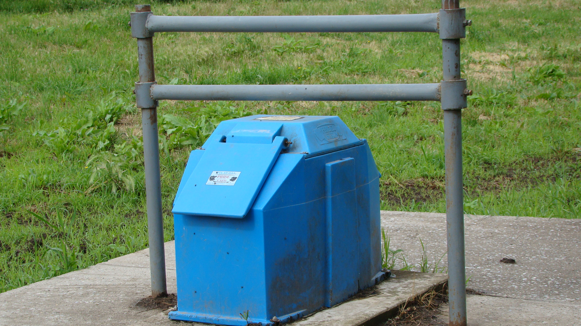
Typical Installation
Notes:
Typical installation that illustrates the step up to the waterer. Animals generally will not back up to a higher level. Whenever MOTHER NATURE calls, this TEN to TWELVE inches spacing away from the waterer will prevent any digestive material from falling into the waterer opening while another animal is drinking.

Slide 3
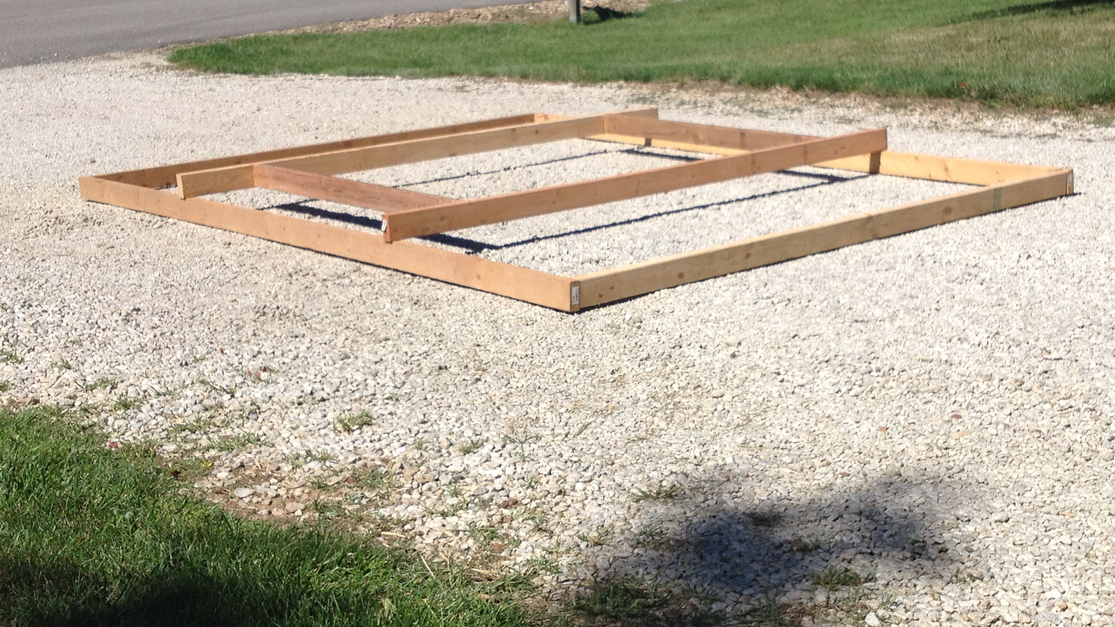
Monolithic Concrete Pad
Notes:
This typical concrete pad has a step-up level that the waterer is set upon.
The lower level is large enough for an animal to comfortably stand on w/o hind legs standing awkwardly in mud hole
Refer to waterer’s dimension and “bridge” 2x4” – 10-12” on all sides of waterer

Slide 4
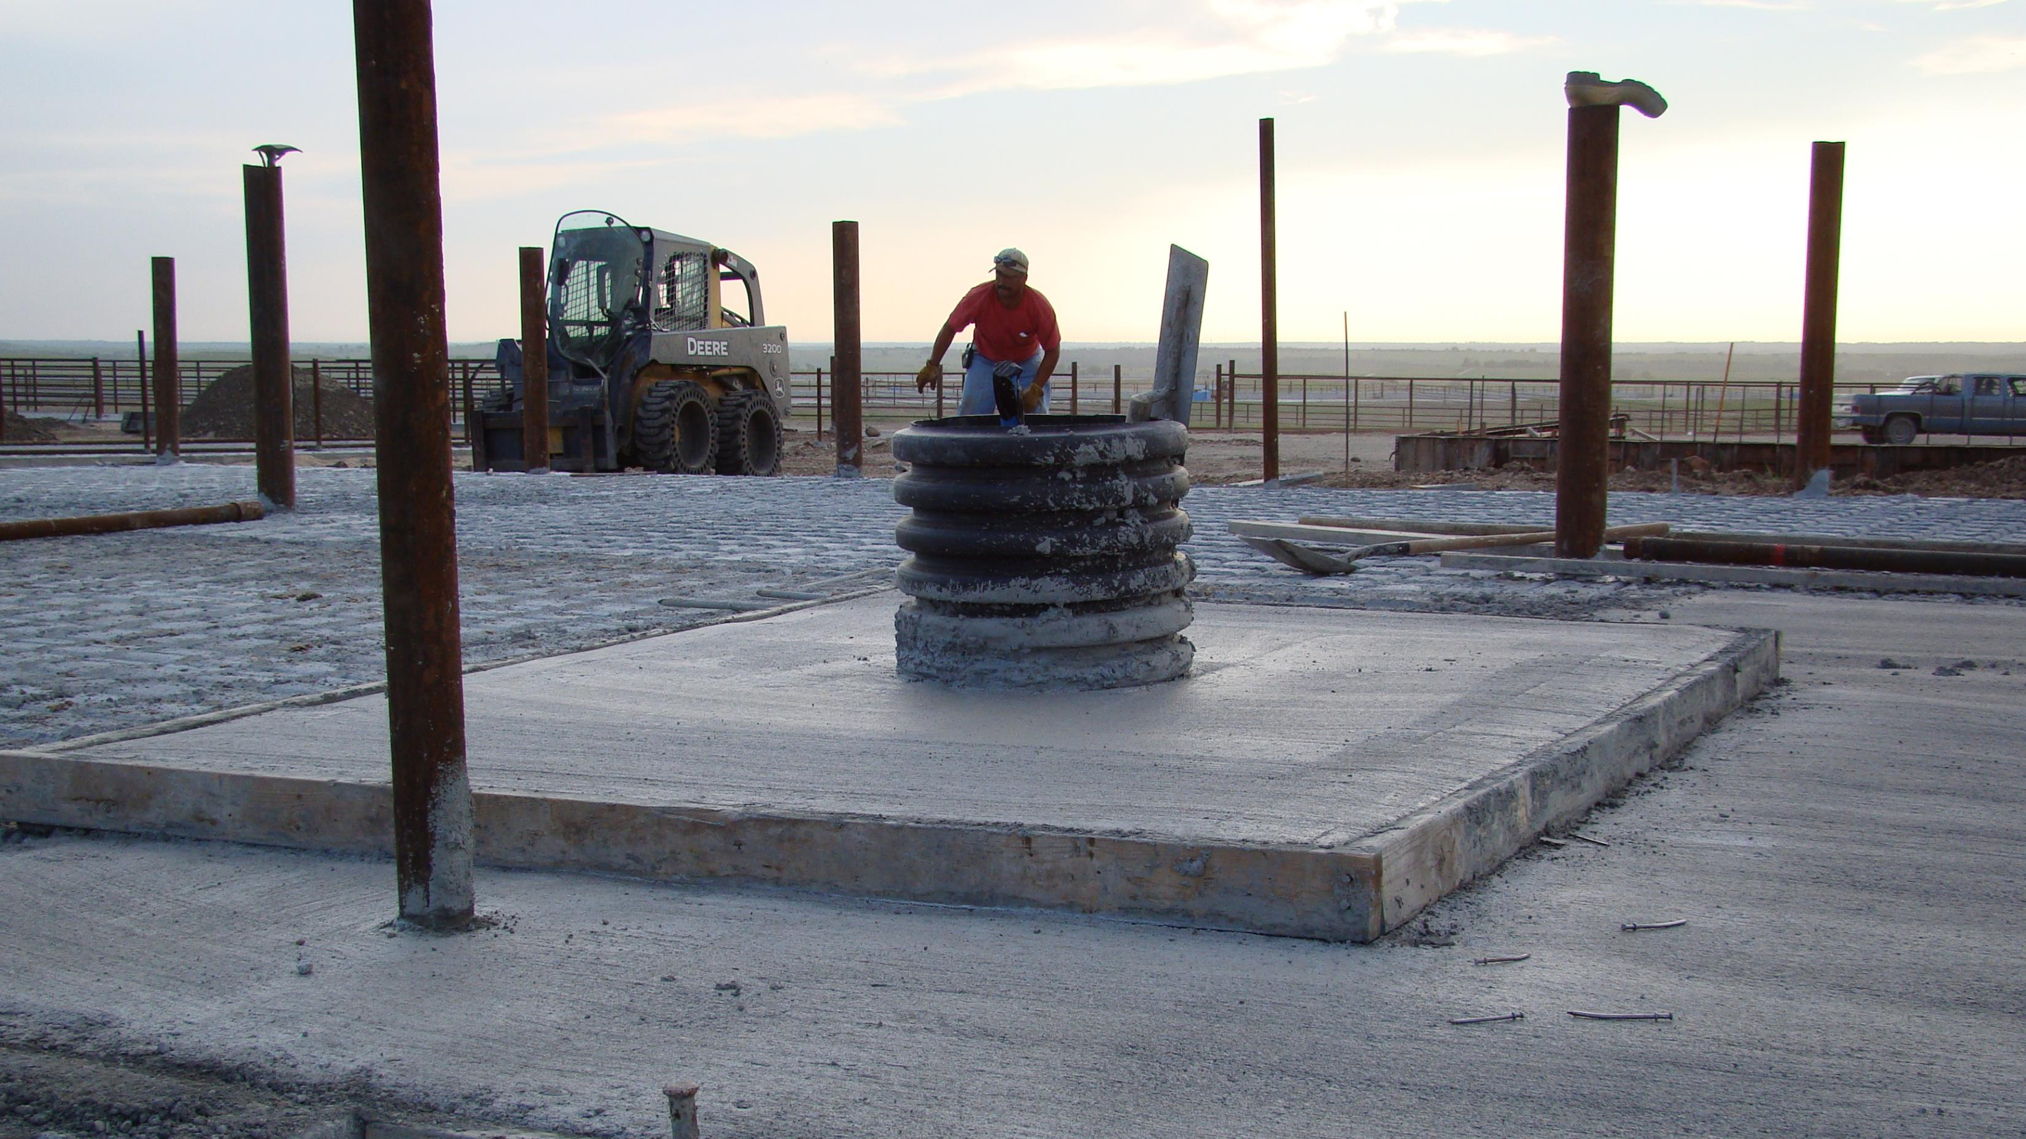
Concrete Pad with Riser Tube and waterline stubbed 36” above slab
Notes:
This feedlot waterer site is using riser tube that’s 10 -14” that will be cut flush with a cut off tool. I like to apply a bead of silicone caulk ONE inch away from the riser tube edge. After 10 – 15 years of operation, I have seen silt and fecal material fill up the riser tube and eventually cause waterline freezes.

Slide 5
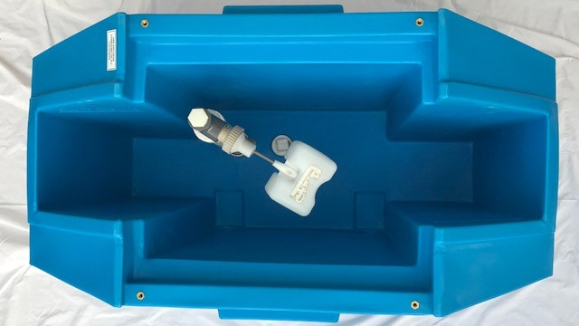
Features of Polar Max Waterer
DRAIN
HOLES
Notes:
3 – 6” of foam insulation
Waterline comes up in middle of the 20 gallons 50* temp
No side access doors – UP NORTH NO ONE PUTS WINDOWS ON THE NORTH SIDE OF THEIR HOUSE (Heat Loss)
2” drain holes
1.5” access ports

Slide 6
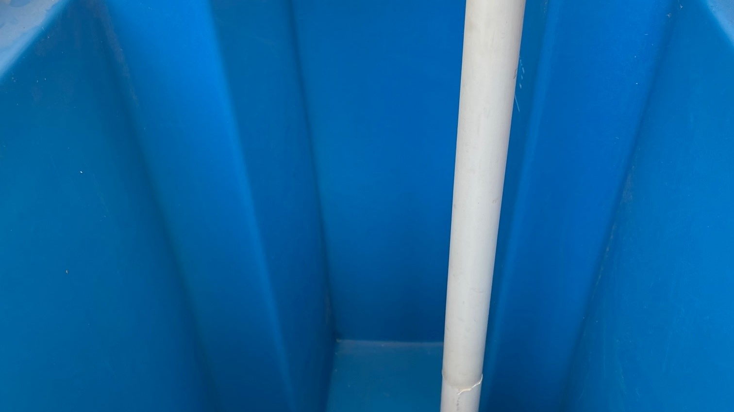
With assistance, lower the waterer onto the concrete pad and bring the ¾” waterline up through the 1-1/2” port labeled “WATER”
¾” PVC PIPE

Slide 7
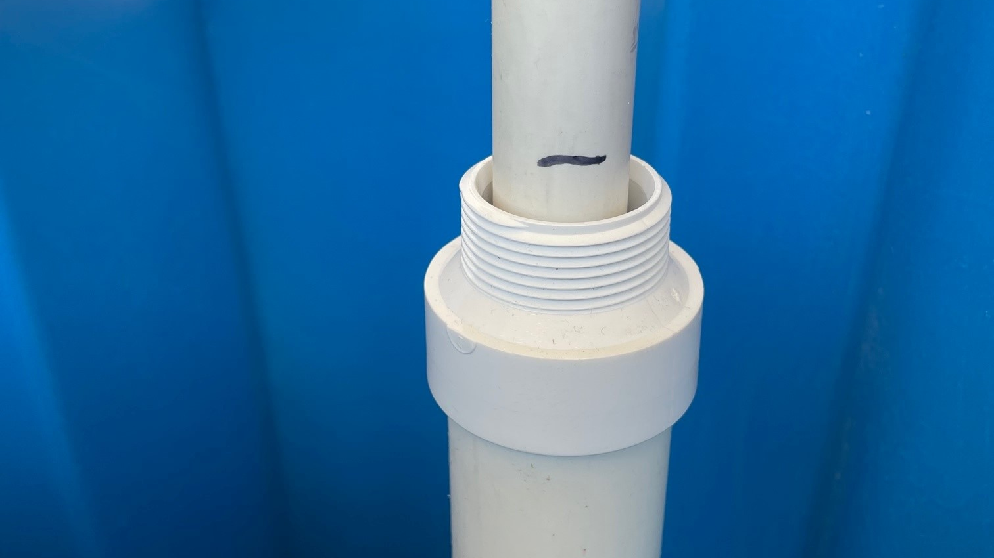
*IMPORTANT*
Before gluing connections - need to get measurements
With rubber O Ring installed on bottom threads, insert 1-1/2” pvc pipe into the WATER port. Use marker to scribe a line 3/8” above 1-1/2” threads
Mount waterer to pad using SS Anchor Bolts – apply anti-seize compound

Slide 8
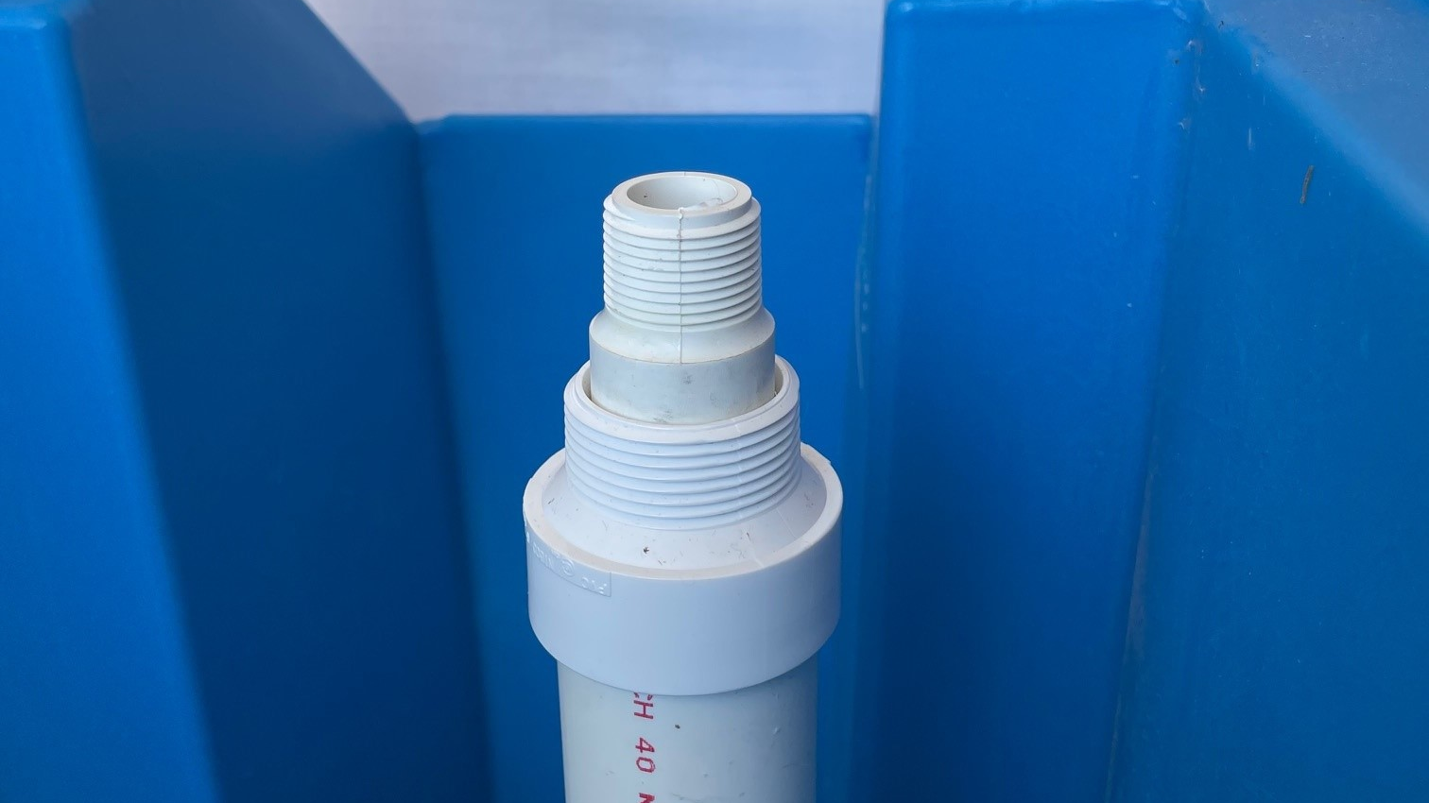
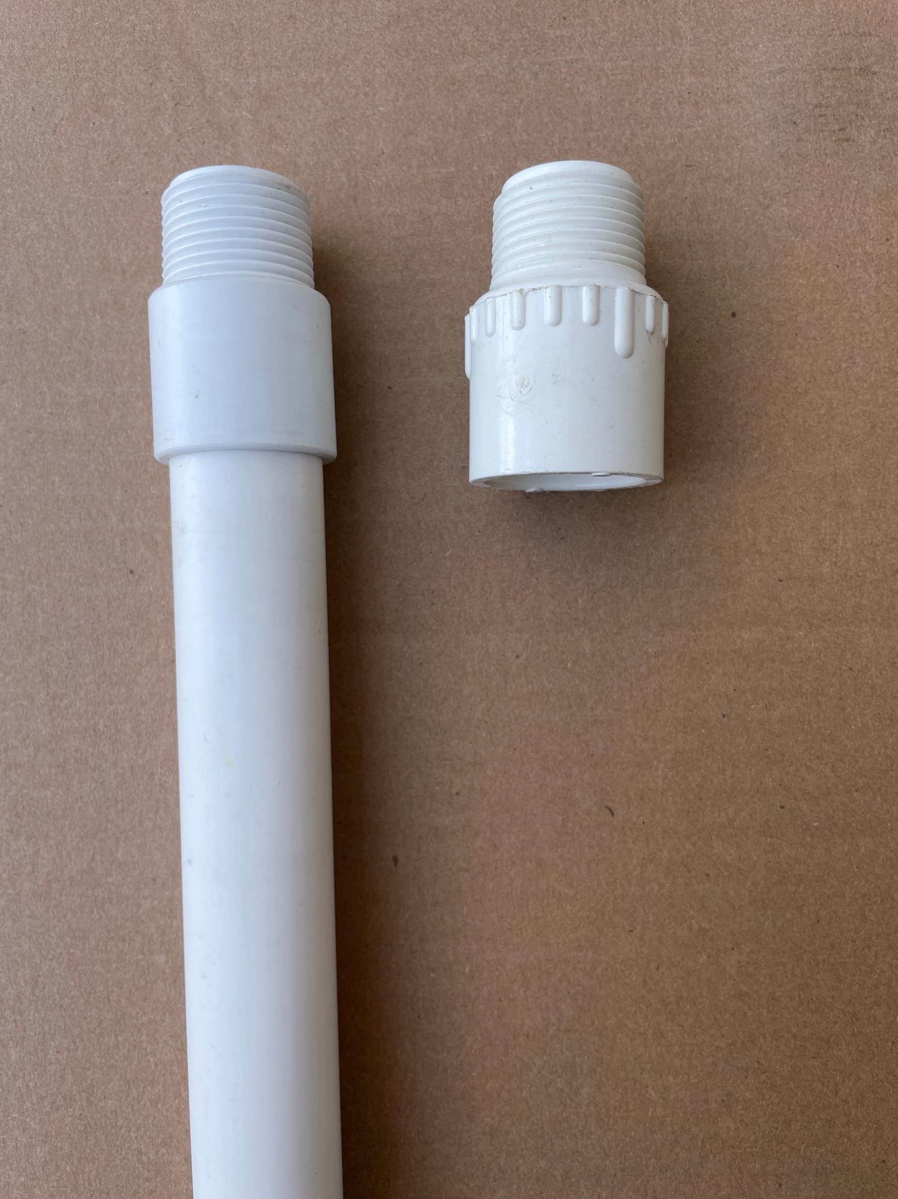
Remove outer
1-1/2” pvc pipe.
Cut ¾” pipe at scribe mark
Glue “machined” ¾” male adapter onto waterline
Reinstall 1-1/2” into bottom port including O Ring and Teflon tape
X
Important: Use machined male adapter and not standard adapter!

Slide 9
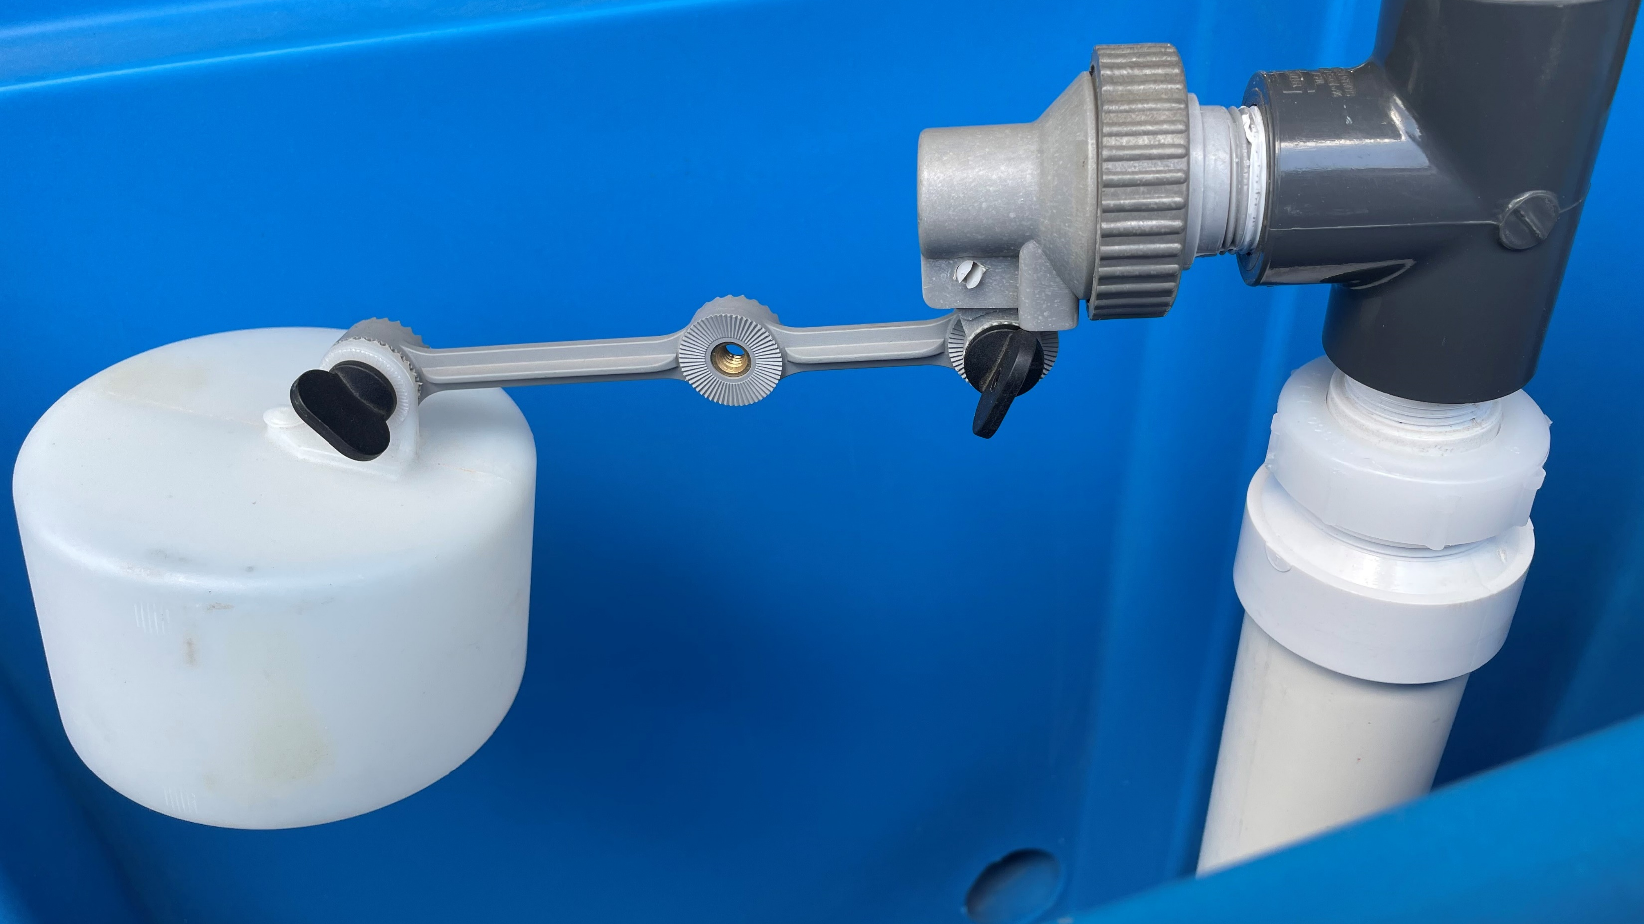
Install 1-1/2” compression ring around ¾” male adapter
Finish install “T”, cap
plug, valve, float arm
and float
Set water level

Slide 10
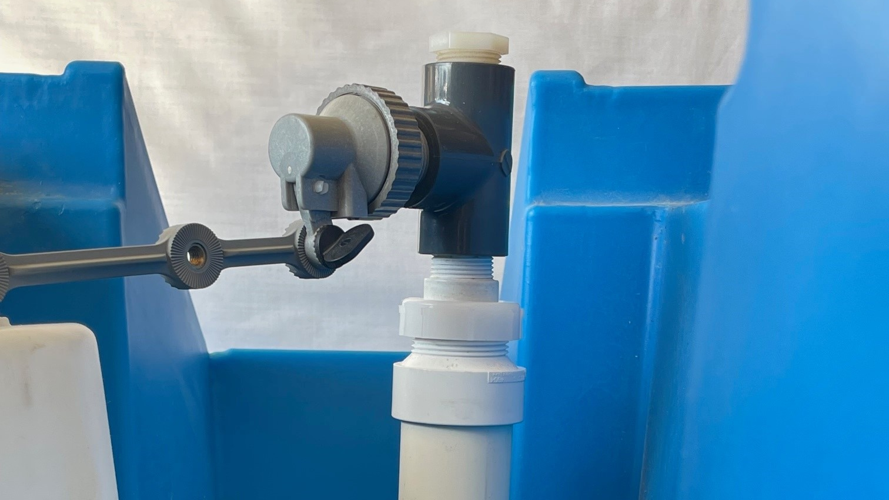
Installation Complete

Slide 11
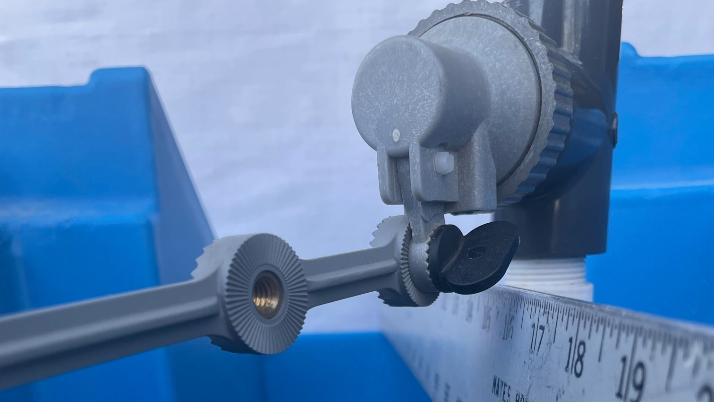
SUMMARY
Brass inserts are featured in float arm to prevent thumbscrew and arm from seizing together and twisting off
Side to Side Straight Edge to illustrate overflow level
Water Valve Outlet
> 2.5” air gap
Notes:
Brass inserts are molded into our 3 in 1 float arm. BIG PROBLEM is plastic against plastic creates friction heat causing the poly material to seize together – thumbscrew twist off.
Float arm length is 6” It can be cut (NOT SNAPPED) to a 4” or 2.5” length.
Attachment point on top of the float is offset allowing more adjustment

